Slide 1
Week 3
Malware and vulnerabilities

Slide 2
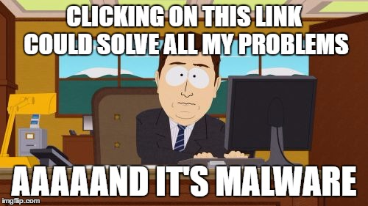
Malware
Why do people make malware?
Ransomware
Zombies

Slide 3
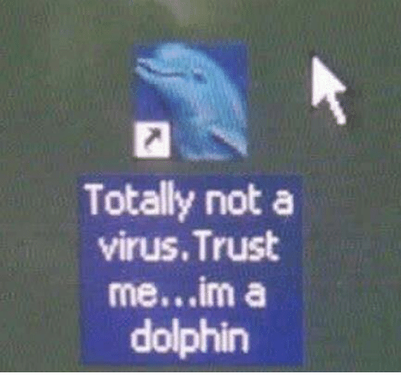
Viruses
Must be run to infect the system
Email attachments
Social media links
Unknown shortened links ( bit.ly)

Slide 4
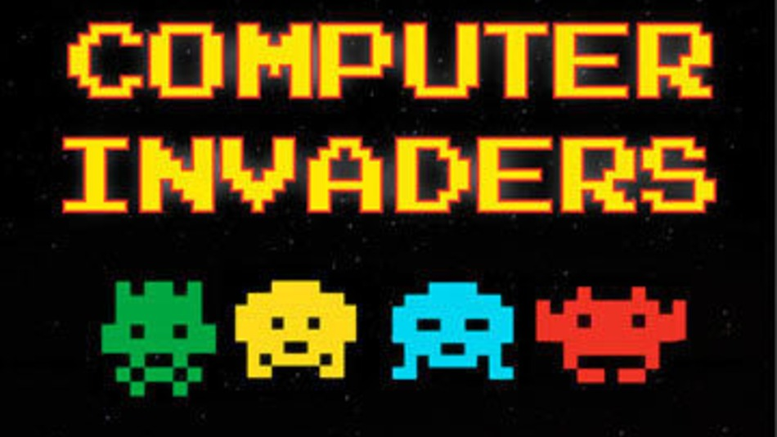
Worms
Come looking for you
Self replicating

Slide 5
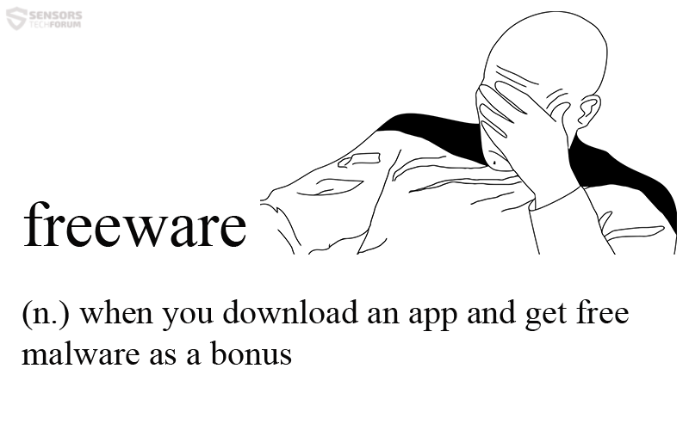
Trojans
Malware embedded in legitimate programs
Free software

Slide 6

Rootkits
Malware that gets deeper into the system then most programs
Can mask the intrusion
Got root?

Slide 7
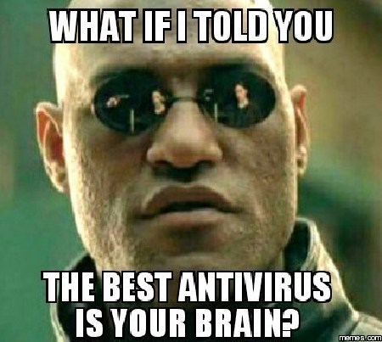
Anti virus software
Databases (fingerprinting)
Behavioral diagnostics
Micro-virtualization

Slide 8
Honeypots
http://www.fireeye.com/cyber-map/threat-map.html
http://map.honeynet.org
http://hp.ipviking.com

Slide 9
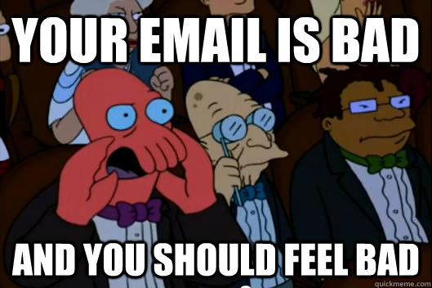
Email
Chain mail
Embedded links
Spam
Phishing

Slide 10
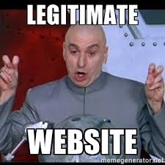
Websites and spoofing
Phishing
Fake URLs
Scareware
Bad ads

Slide 11
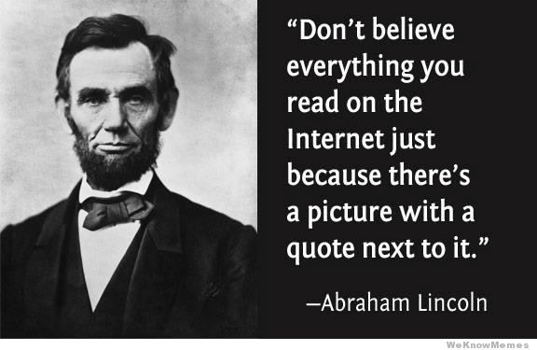
Social media and fake news
Viral news stories
Fact checking
Trust and the internet

Slide 12
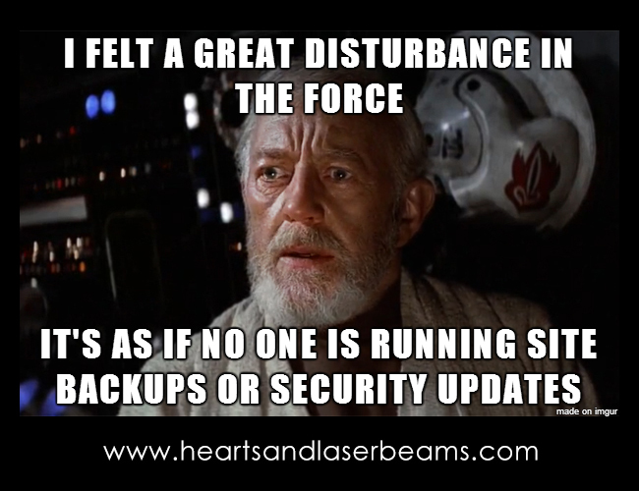
Vulnerabilities:Updating software
What happens if you don’t update
What happens if you do
Does everything still run?
Was the update legitimate?

Slide 13
Vulnerabilities: zero day expoilts
Window of vulnerability
Zeroday emergency response team (ZERT)
Non vendor patches
Selling zeroday exploits
Ethics!

Slide 14
Vulnerabilities: hardware and networking
Printers
Switches
Routers

Slide 15
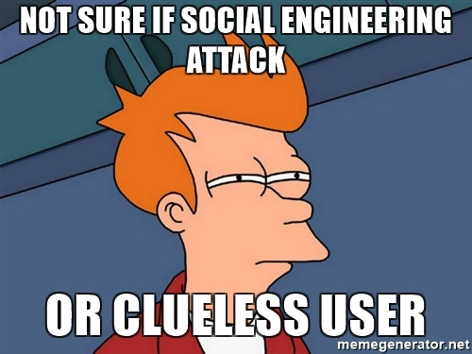
Vulnerabilities:Social engineering

